Slide 1
EZEKIEL 38
A PROPHESY AGAINST GOG,
OF THE LAND OF MAGOG:
PREPARE for the SHOAH! שוא
PROPHETIC CONVOCATION
AUGUST 26, 2016
MADISON, OHIO

Slide 2
MENTION CONTINUITY OF IMAGRY (SHOAH)
יְהֹוָה נִסִּי
Notes:
Source: https://www.blueletterbible.org/lang/lexicon/lexicon.cfm?Strongs=H5251

Slide 3
The Everlasting Enmity

Slide 4
And the word of יְהוָה came unto me, saying: Son of man, set your face toward GOG, of the land of Magog, the Chief Prince רֹאש of Meshech & Tubal & prophesy against him & say: Thus says the Lord God: Behold, I am against you, Oh Gog, Chief Prince of Meshech & Tubal & I will turn you about & put hooks into your jaws & I will bring you forth & all your army, horses & horsemen, all of them clothed most gorgeously, a great company with buckler and strong shield, all of them handling swords; Persia, Cush & Put פָּרַס כּוּשׁ וּפוּט with them, all of them with shield & helmet; Gomer & all his bands; the house of Togarmah in the uttermost parts of the north, and all his bands [allies]; even many peoples with thee. Sheba and Dedan, and the merchants of Tarshish, with all the ravening lions thereof, shall say unto you: ‘Have you come to take the spoil’?
Notes:
Ezekiel 38.1-6; 13

Slide 5
“Be prepared, and prepare yourself, you [= Gog], and all your companies that are assembled about you, and be a guard for them.
Notes:
Source: https://www.blueletterbible.org/kjv/eze/38/7/t_conc_840007

Slide 6
In Jewish writings, Gog / Magog is a frequent, standard expression for the rebellious nations of Psalm 2, which gather together…
‘Against the Lord, the Land & His Anointed.’
Days of Vengeance, David Chilton, p. 523
And [Satan] shall go out to deceive the nations which are in the four quarters of the earth, Gog & Magog, to gather them together to battle, the number of whom is as the sand of the sea.
Revelation 20.8 (KJV)
Notes:
Source: http://www.free-bible-study-lessons.com/gog.html

Slide 7
FIRST, SOME HISTORICAL
PERSPECTIVE
WITH A FEW HISTORIC MAPS
Someone please read Acts 17.26-27
Mention Ethnos ἔθνος
A tribe, nation, people group
Notes:
And He made from one man every nation [ἔθνος] of mankind to live on all the face of the earth, having determined their appointed times and the boundaries of their habitation, 27that they would seek God, if perhaps they might grope for Him and find Him, though He is not far from each one of us;…

Slide 8
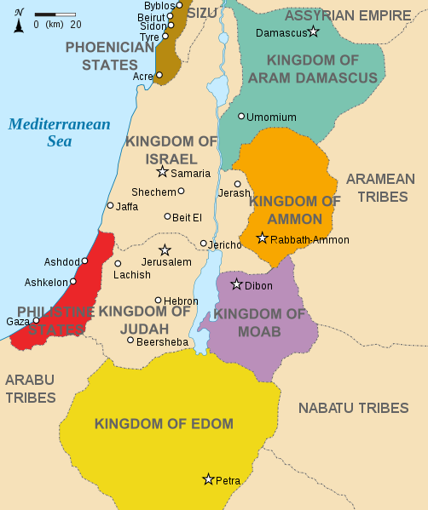
Bible Times
Obadiah – Psalm 83 – Psalm 137
Isaiah 63 – Ezekiel 38 – Joel 3.19
Notes:
Add Joel 3:19 Egypt shall be a desolation, and Edom shall be a desolate wilderness, for the violence against the children of Judah, because they have shed innocent blood in their land.
Source of Map: http://en.wikipedia.org/wiki/File:Kingdoms_around_Israel_830_map.svg

Slide 9
1851
After conquest by the Mamluks in the early 1500’s, Ottoman Syria was organized into the Eyalets (Provinces) of Damascus & Aleppo. The Elayet of Tripoli was formed in 1579 & the Eyalet of Safed (=Sidon) was established in 1660. Following the Tanzimat reforms in 1864, these Eyalets were transformed into the Vilayets of Syria, Aleppo & Beirut.
Notes:
Ottoman Syria became organized by the Ottomans upon conquest from the Mamluks in the early 16th century into Eyalets (provinces) of Damascus and Aleppo. Elayet of Tripoli was formed in 1579 and later Eyalet of Adana was split from Aleppo. In 1660, Eyalet of Safed was established and shortly renamed into Eyalet of Sidon. The Eyalets were later transformed into the Vilayet of Syria, the Vilayet of Aleppo and the Vilayet of Beirut, following the 1864 Tanzimat reforms.

Slide 10
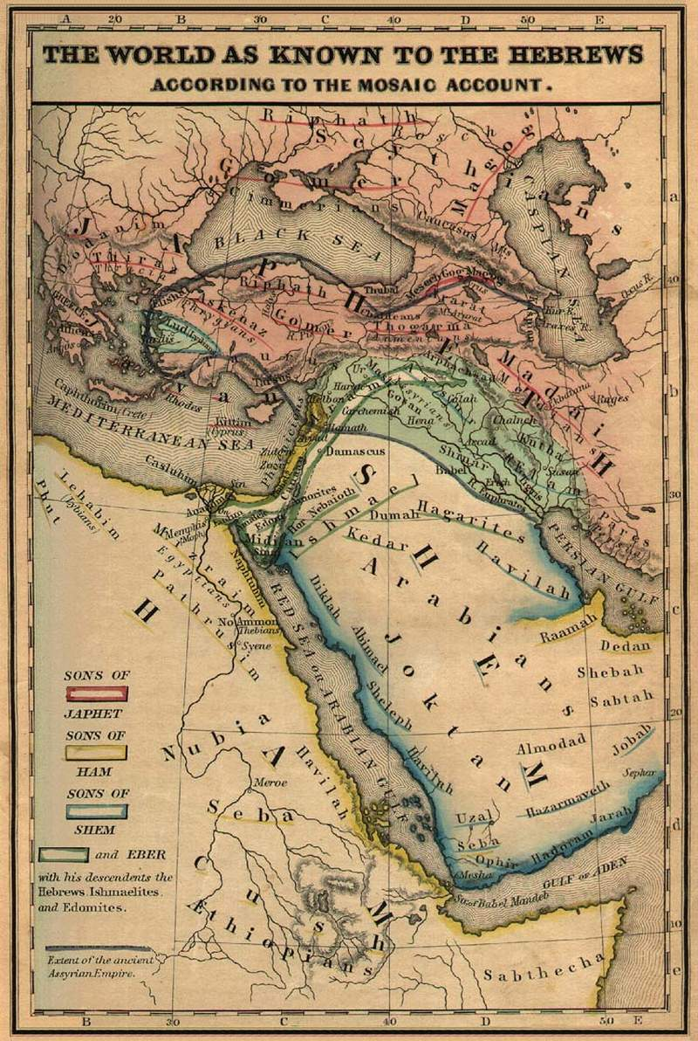
1854
Notes:
Source of Map: http://www.godweb.org/maps/131.htm
Also See: The Historical Atlas by William R. Shepherd, 1923
The World As Known To The Hebrews, a map from the Historical Textbook and Atlas of Biblical Geography by Coleman, written in 1854, clearly identifies the nations of Magog, Meschech, Tubal, Ashkenaz, and Gomer as being in the region of the Caucasus and Turkey.
Source of Quote: http://johnthewitness.wordpress.com/2012/06/29/the-muslim-brotherhood-victories-in-egypt-will-lead-to-counterfeit-gog-and-magog-war/
Also: “In his multi-volume work called The Natural History, Pliny identifies the ancient Lydian city of Hierapolis as being part of Magog. Built atop the cliffs, the city of Hierapolis controlled the water supply of the Lydian city of Laodicea six miles to the south. The city of Hierapolis was built by the Lydians and always under Lydian control until the Lydian Kingdom became part of the Persian Empire in 546 BC and then part of the Greek and Roman Empires that followed. Like Pliny, today’s archeologists also identify Magog with the ancient nation of Lydia, which was in western Asia Minor. Indeed, written records from the Assyrian royal court show that the Assyrians used the name Magog as an eponym for the nation of Lydia. In his book Pliny writes, “Bambyx the other name of which is Hierapolis, but by the Syrians called Magog.” In other words, Pliny identifies the famed Lydian city of Hierapolis as being part of Magog. In this we see that Magog is another name for the ancient nation of Lydia.”

Slide 11
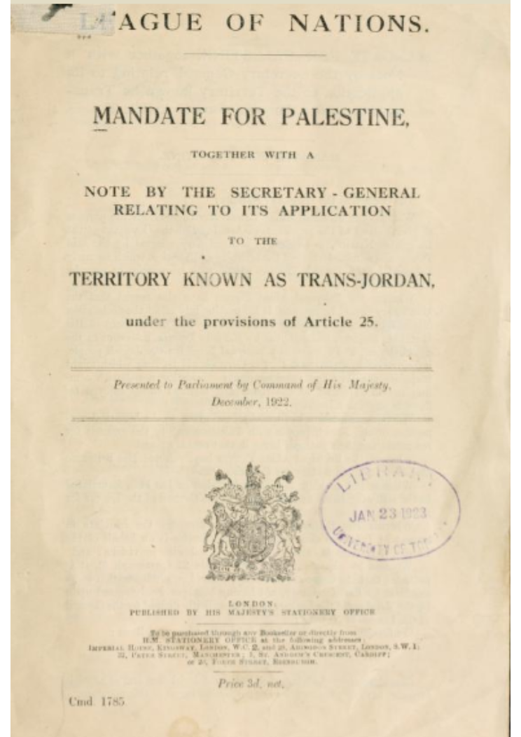
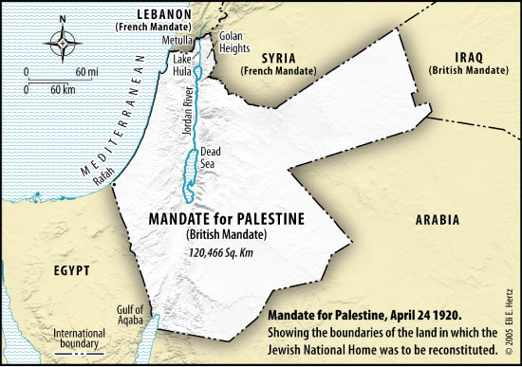
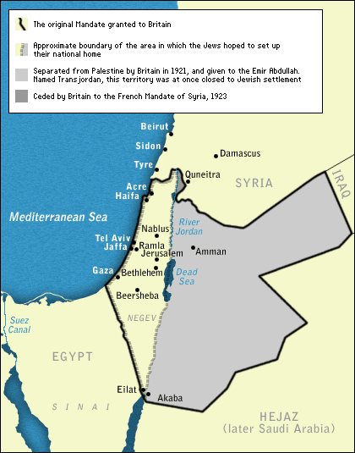
1920
This event, which occurred 27 years before modern Israel was created, is a starting point for discussing Psalm 2 & Psalm 83
1921
Notes:
Source: http://upload.wikimedia.org/wikipedia/commons/c/c5/Mandate_for_Palestine_(legal_instrument).svg
Mandate for Palestine 1920: http://www.justicenow4israel.com/image/1920-boundaryconventionmap.jpg
Mandate for Palestine 1923: http://www.npr.org/news/specials/mideast/history/images/map02.gif

Slide 12
SO…WHAT DOES THIS LOOK LIKE IN OUR WORLD TODAY?
Notes:
And He made from one man every nation [ἔθνος] of mankind to live on all the face of the earth, having determined their appointed times and the boundaries of their habitation, 27that they would seek God, if perhaps they might grope for Him and find Him, though He is not far from each one of us;…

Slide 13
GLOBAL
PERSPECTIVE

Slide 14
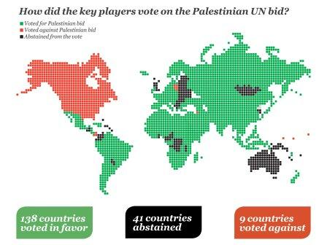
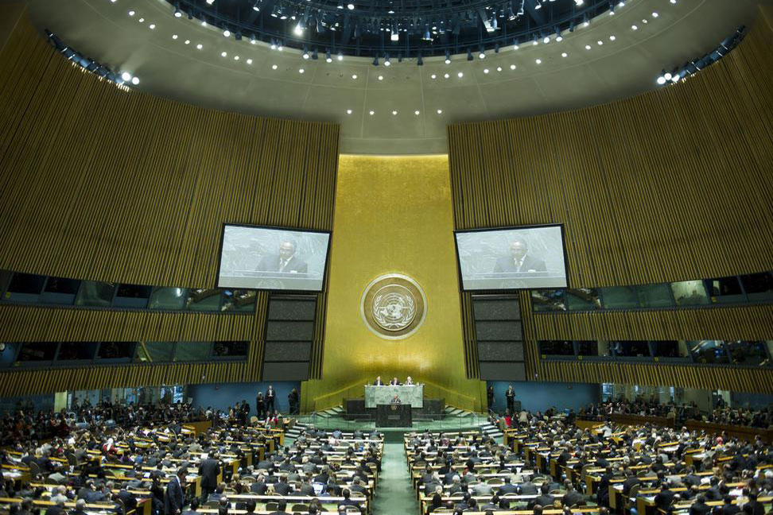
In an historic vote at the UN on Thursday, November 29, 2012, exactly 65 years after passing the Partition Plan for Palestine, the General Assembly voted by a huge majority to recognize Palestine within the 1967 borders as a non-member state with observer status in the UN. 138 countries voted in favor of the resolution, 41 abstained & 9 voted against: Canada, Czech Republic, Israel, Marshall Islands, Micronesia, Nauru, Palau, Panama and USA.
November 29, 2012: The UN Votes for Palestine Statehood
יִתְיַצְּבוּ מַלְכֵי-אֶרֶץ *וְרוֹזְנִים נוֹסְדוּ-יָחַד
The kings of the earth stand up, & the rulers take counsel together
The support of the countries of the world for our endeavor is a victory for truth, freedom, justice, law & international legitimacy, and it provides tremendous support for the peace option and enhances the chances of success of the negotiations. Your support for the establishment of the State of Palestine & for its admission to the UN as a full member is the greatest contribution to peacemaking in the Holy Land.
Notes:
Source: http://blogs.elca.org/peacenotwalls/files/2012/11/unbidvote2012web.jpg
Quote Source: http://blogs.elca.org/peacenotwalls/history/palestine-becomes-un-non-member-state-with-observer-status-30
UN Picture Source: http://www.un.org/News/dh/photos/large/2012/November/536248-palestinobserve.jpg

Slide 15
ISLAMIC
PERSPECTIVE

Slide 16
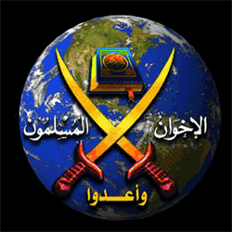

Slide 17
And prepare (make ready) against them whatever you are able of weapons of war, by which you may terrify the enemy of Allah.
Notes:
Source: http://corpus.quran.com/wordmorphology.jsp?location=(8:60:1)

Slide 18
القاعدة
Al-Qaeda Al-Muslamina Al-Moltzema
Notes:
Source: http://www.investigativeproject.org/documents/misc/20.pdf
Via email 01-29-13: HANEY, when it comes to the Brotherhood, the word “obedient” is the mandatory thing to be part of them [and] to the El Morshed (Ayatollah). Here the phrase (El Qada El Islamia El Moltzema) means (The Obedient Islamic Base), so they get their orders from El Morshed without discussing it. Good luck brother…Mina

Slide 19
‘What your right hand possesses’
Notes:
Source: http://corpus.quran.com/translation.jsp?chapter=4&verse=3

Slide 20
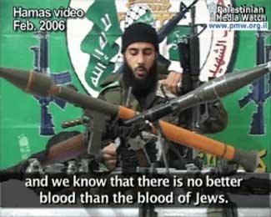
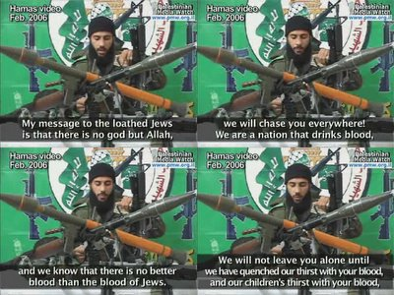
February 2006
Notes:
Source: http://bokertov.typepad.com/btb/images/no_better_blood.jpg
Source Bottom: http://photos1.blogger.com/blogger/4765/1487/400/htdbljpw.jpg

Slide 21
לא-יִשָּׁמַע עוֹד חָמָס בְּאַרְצֵךְ
NO LONGER SHALL YOU HEAR VIOLENCE IN YOUR LAND
Notes:
Isa 60:18 There will never again be violence in your land (country). People will never again attack your country and steal from you. You will name your walls, 'Salvation,' and your gates, 'Praise.'
Source: http://www.washingtonpost.com/world/foreign-fighters-flow-to-syria/2014/10/11/3d2549fa-5195-11e4-8c24-487e92bc997b_graphic.html

Slide 22
A NEW TESTAMENT PERSPECTIVE

Slide 23
The night is almost finished. The day is almost here. So we should stop doing whatever belongs to darkness. We should prepare ourselves to fight evil with the weapons that belong
to the light.
Notes:
Source: https://www.bible.com/bible/406/rom.13.12.erv#!

Slide 24
Notes:
Source: https://www.blueletterbible.org/lang/lexicon/lexicon.cfm?strongs=G3904&t=KJV

Slide 25
WE SHOULD ALSO BE
PREPARED…
TO RESIST
DECEPTION

Slide 26
O People of the Book! Come to common (equitable) terms سَوَاءٍ (Sawain) between us & you – that we [1] worship none but Allah; that we [2] associate no partners with him & that we [3] erect not, from among ourselves, lords & patrons other than Allah. If then they turn back, say ‘Bear witness that we are Muslims (Q 3.64)

Slide 27
Notes:
Source: http://www.huffingtonpost.com/ian-mevorach/muhammad-as-spirit-of-tru_b_9389642.html?

Slide 28
CURRENT
EVENTS

Slide 29
LIBYA פוּט
(NORTH AFRICA)
Notes:
Source:

Slide 30
December 13, 2013
Notes:
Source: http://www.frontpagemag.com/2013/dgreenfield/obama-turned-benghazi-into-al-qaeda-terrorist-hub/

Slide 31
January 14, 2014
Notes:
Prophetic Perspective
Source: http://magharebia.com/en_GB/articles/awi/features/2014/01/14/feature-02

Slide 32
Notes:
Source: http://www.activistpost.com/wp-content/uploads/2011/10/Libya-before-and-after2.jpg

Slide 33
CUSHכּוּשׁ
(HORN OF AFRICA)
Notes:
Source:

Slide 34
June 28, 2012
Notes:
Source: http://freebeacon.com/obamas-sudan-shuffle/

Slide 35
November 20, 2013
Notes:
Source: http://us6.campaign-archive1.com/?u=7ec6d7eb2533a90581f839110&id=ab2c596c4b&e=668afb64c3

Slide 36
FARS פָּרַס
(PERSIA = IRAN)
Notes:
Source:

Slide 37
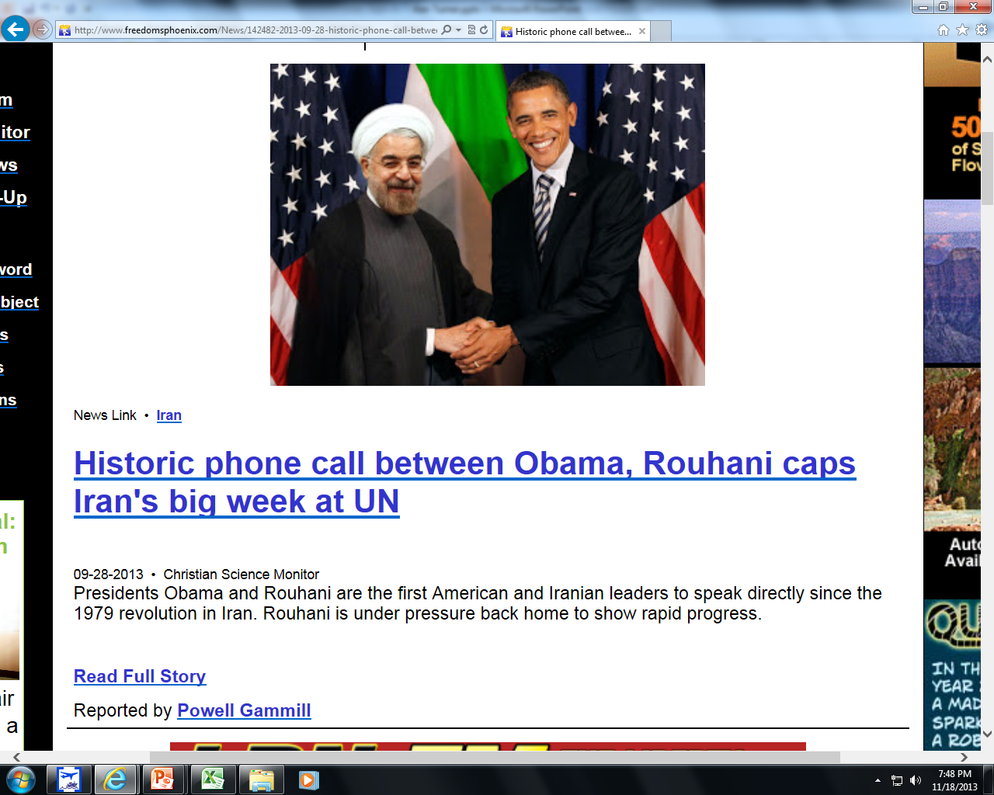
September 15, 2013
Here is a picture of ‘Rosh’(North) & Iran together
September 28, 2013
Notes:
Source: http://www.freedomsphoenix.com/News/142482-2013-09-28-historic-phone-call-between-obama-rouhani-caps-irans-big-week.htm
Source Iran’s Rouhani: http://www.theguardian.com/world/2013/sep/15/obama-rouhani-united-nations-meeting

Slide 38
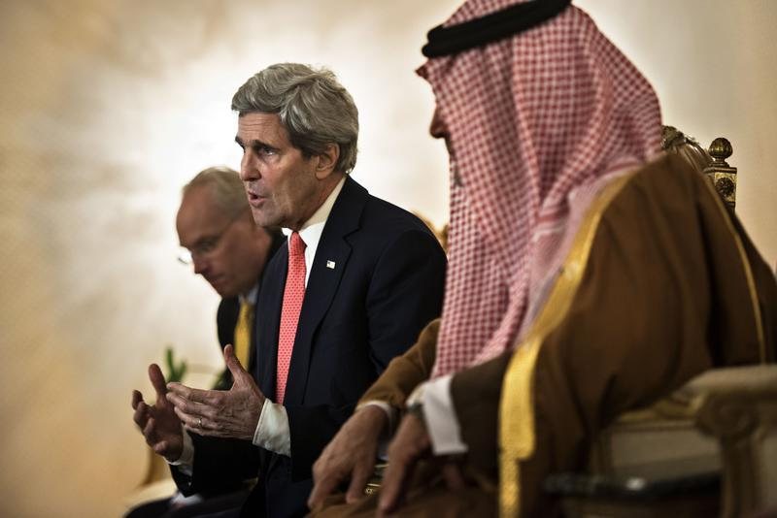
November 14, 2013
Notes:
Source: http://www.israelnationalnews.com/News/News.aspx/173994#.Uoa_XMIo671
Source Picture: http://www.blog.standforisrael.org/articles/the-death-of-a-mideast-theory

Slide 39
December 12, 2013
Notes:
Source: http://www.globalmbwatch.com/2013/12/12/senior-hamas-official-hamas-iran-resuming-relations/

Slide 40
August 25, 2016
Notes:
Source: http://www.frontpagemag.com/fpm/263957/obama-provides-iran-13-billion-where-did-money-go-ari-lieberman

Slide 41
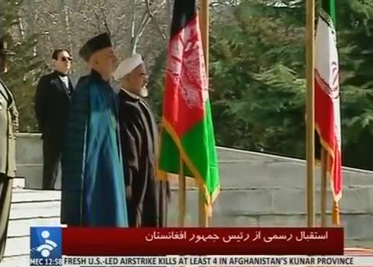
MEANWHILE, IRAN HAS A ‘NEW’ ALLY:
AFGHANISTAN
December 13, 2013
Afghanistan & Iran Strike Cooperation Pact Amid Tensions With US
Notes:
Source: http://www.wisconsinrapidstribune.com/article/20131213/WRT06/312120251/Letter-Afghanistan-leader-lousy-ally
http://cdn.newslook.com/f0/f05393d55233c979963129d0323a64e1/images/frame_0006.jpg

Slide 42
Meshech & Tubal
Gomer & Togarmah
(= TURKEY / SYRIA RUSSIA / CAUCASIANS)
aka Rosh / Scythians
The ancient Jewish historian Josephus identifies them as the Scythians: “Magog founded those that from him were named Magogites, but who are by the Greeks called Scythians.” Josephus 1:6:1
Notes:
Source:

Slide 43
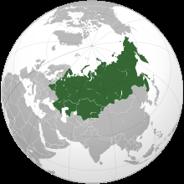
December 20, 2012
The circled area includes Gomer, Meshach, Tarshish, Togarmah, & Tubal; beyond this are the ‘uttermost parts of the north.’
Notes:
Source: http://www.bne.eu/story4391/Tajikistan_and_Kyrgyzstan_ready_to_join_Customs_Union
Map Source: http://en.wikipedia.org/wiki/File:Customs_Union_of_Belarus,_Kazakhstan,_and_Russia_(orthographic_projection).svg

Slide 44
February 18, 2013
Notes:
Source: http://todayszaman.com/news-307569-.html

Slide 45
September 12, 2013
Notes:
Source: http://frontpagemag.com/2013/joseph-klein/russia-rising/

Slide 46
November 08, 2013
November 08, 2013
●Erdogan remains intent on unseating President Bashar Assad, who was one of his early allies.
●He continues to strongly support the Muslim Brotherhood, which has pitted Turkey against the current Egyptian ruler, General Abdel Fattah al-Sisi.
●Turkey is viewed with suspicion by the Palestinian Authority because of its strong backing of their mortal rival HAMAS.
●Relations with Saudi Arabia have also cooled off, partly because Turkey, which has a Sunni majority, has started repairing ties with Shiite powers, including not only Iraqi Prime Minister Nouri Al-Maliki but, most troubling to America, the mullahs who rule Iran.
Notes:
Source: http://www.newsweek.com/turkeys-erdogan-quietly-wooing-americas-enemies-2846

Slide 47
Oct. 19, 2015
Notes:
Source: http://www.asianews.it/news-en/Putin-proposes-immunity-for-sacred-texts:-they-cannot-be-judged-extremist-35620.html
http://www.jihadwatch.org/2015/10/putin-proposes-immunity-for-sacred-texts-they-cant-be-judged-extremist

Slide 48
April 11, 2016
Notes:
Source: http://finance.yahoo.com/news/russia-begins-shipping-advanced-missiles-195000292.html;_ylt=A0LEVxoxi8BXjZEAQpxXNyoA;_ylu=X3oDMTEyNnQ4cHI3BGNvbG8DYmYxBHBvcwMxBHZ0aWQDVUkyQzNfMQRzZWMDc3I-

Slide 49
July 17, 2016
Notes:
Source:

Slide 50
August 16, 2016
Notes:
Source: http://www.nytimes.com/2016/08/17/world/middleeast/russia-iran-base-syria.html?_r=0

Slide 51
August 27, 2016
Notes:
Source: https://www.washingtonpost.com/news/worldviews/wp/2016/08/27/istanbuls-new-3-billion-bridge-has-a-very-divisive-name/

Slide 52
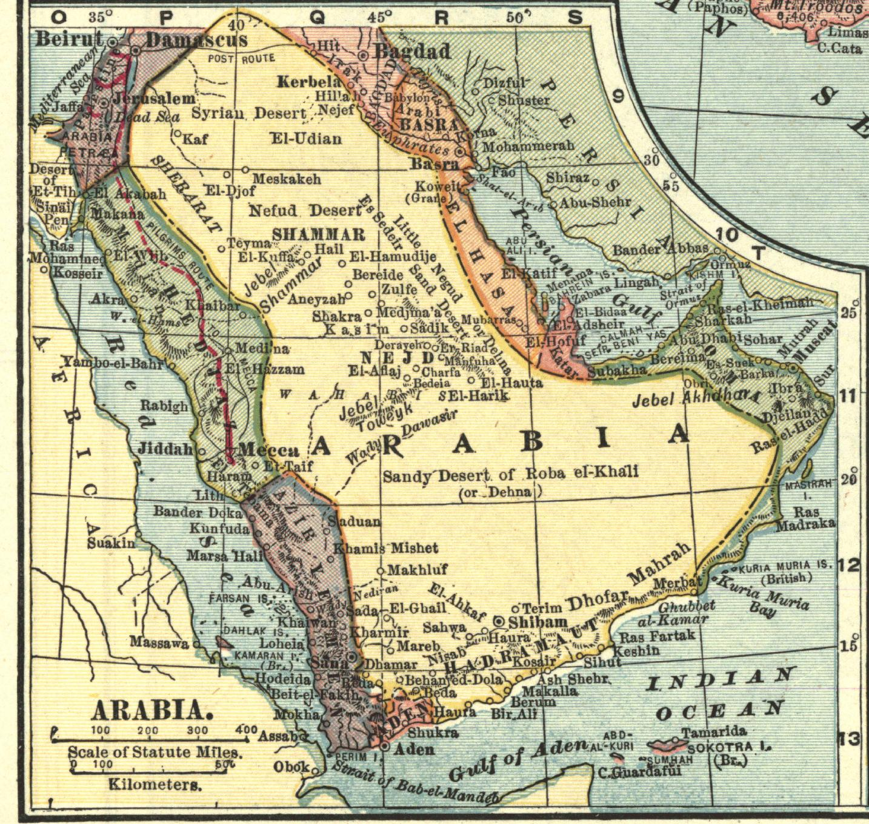
SHEBA & DEDAN
(ARABIAN PENNINSULA)
1909
Notes:
Source: http://upload.wikimedia.org/wikipedia/commons/a/aa/Arabian_peninsula,_1909_(cropped).jpg

Slide 53
October 22, 2013
Notes:
See http://frontpagemag.com/2013/caroline-glick/israels-european-challenge/print/
Source: http://www.dailymail.co.uk/news/article-2472680/Saudi-Arabia-severs-diplomatic-ties-US-response-conflict-Syria.html

Slide 54
August 25, 2016
Notes:
Source: http://www.frontpagemag.com/fpm/263953/war-and-peace-putins-middle-east-p-david-hornik

Slide 55
WHAT ABOUT
AMERICA & ISRAEL?
Notes:
Source:

Slide 56
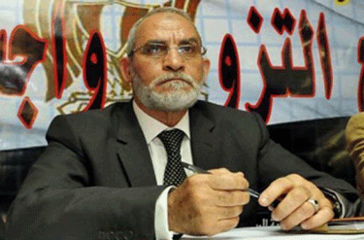
Obama Camp Prepared To Talk To Hamas
Thursday, January 08, 2009
‘The incoming administration will abandon Bush’s isolation of the Islamist group [HAMAS] to initiate low-level diplomacy,’ say transition sources.
US Shifts To Closer Contact With Egypt Islamists
Thursday, June 30, 2011
The US will resume limited contacts with Egypt’s Muslim Brotherhood, Secretary of State Clinton confirmed, saying it was in Washington’s interests to deal with parties committed to non-violent politics.
While Clinton portrayed the Administration’s decision as a continuation of an earlier policy, it reflects a subtle shift in that US officials will be able to deal directly with officials of the Islamist movement who are not members of parliament [outside the elected government].
Notes:
Source of Obama Camp Prepared To Talk To Hamas:
http://www.guardian.co.uk/world/2009/jan/08/barack-obama-gaza-hamas
Source of US Shifts To Closer Contact Quote:
http://www.reuters.com/article/2011/06/30/us-usa-egypt-brotherhood-idUSTRE75T0GD20110630
Source of M. Badie Picture: http://frontpagemag.com/2011/robert-spencer/obama-reaches-out-to-the-muslim-brotherhood/

Slide 57
December 24, 2013
Notes:
Source: http://www.globalmbwatch.com/2014/01/03/state-department-expresses-concern-egyptian-designation-muslim-brotherhood-terrorist-group/
http://www.globalmbwatch.com/2014/01/02/egypt-declares-muslim-brotherhood-terrorist-organization/

Slide 58
December 24, 2013
Notes:
Source: http://www.globalmbwatch.com/2014/01/03/state-department-expresses-concern-egyptian-designation-muslim-brotherhood-terrorist-group/
https://counterjihadreport.com/2014/01/03/us-state-department-expresses-concern-over-egyptian-designation-of-muslim-brotherhood-as-terrorist-group/
http://www.globalmbwatch.com/2014/01/02/egypt-declares-muslim-brotherhood-terrorist-organization/

Slide 59
January 04, 2014
“Security must remain in our hands. Anyone who proposes a solution in the Jordan Valley by deploying an international force, Palestinian police or technological means…does not understand the ME,” Intelligence Minister Yuval Steinitz told Israeli public radio.
Palestinian hopes of having an international force brought in to help patrol the Jordan Valley under a peace deal had been sidelined, a Palestinian source told AFP.
Notes:
Source: http://news.yahoo.com/israel-rejects-us-proposals-jordan-valley-062624232.html
Kerry says progress in peace talks but more work needed AFP
Kerry says Mideast plan will be 'fair, balanced' AFP
Israel, Palestinians talk tough ahead of Kerry visit AFP
Israel official: Jordan Valley must remain border Associated Press
Kerry launches 2014 with all-out bid for Mideast peace AFP

Slide 60
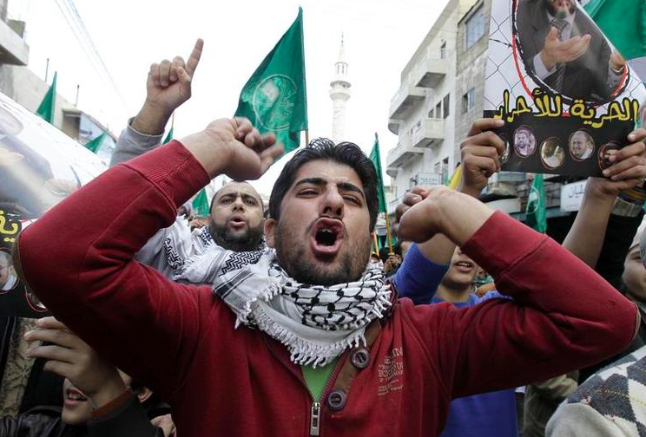
December 01, 2014
Notes:
Source: http://www.theblaze.com/stories/2014/12/01/after-more-than-a-year-this-is-the-white-houses-response-to-a-petition-to-declare-the-muslim-brotherhood-a-terrorist-group/
Caption: Supporters of the Muslim Brotherhood shout slogans during an anti-Israel demonstration in the Jordan capital of Amman, Nov. 28, 2014. (AFP/Khalil Mazraawi)
http://www.jihadwatch.org/2014/12/obama-white-house-refuses-to-declare-muslim-brotherhood-a-terrorist-org
We The People Sources: https://petitions.whitehouse.gov/petition/declare-muslim-brotherhood-organization-terrorist-group/zGxCQ55g
https://petitions.whitehouse.gov/response/response-we-people-petition-muslim-brotherhood

Slide 61
August 12, 2015
August 12, 2012
Notes:
Note: The BHO Administration was actively supporting the Salafis in Syria; this ties right in w/ Benghazi; the memo is dated 08-12-12, just one month the attack in Benghazi
Source: http://www.judicialwatch.org/document-archive/pgs-287-293-291-jw-v-dod-and-state-14-812-2/
Also See: http://levantreport.com/2015/05/19/2012-defense-intelligence-agency-document-west-will-facilitate-rise-of-islamic-state-in-order-to-isolate-the-syrian-regime/

Slide 62
Now when all these things begin to take place, straighten up (unbend) & raise up your heads, because your redemption (deliverance) draws near!
Rise Shine, For Your
Light Has Come!
Notes:
Luke 21.28 English Standard Version

Slide 63
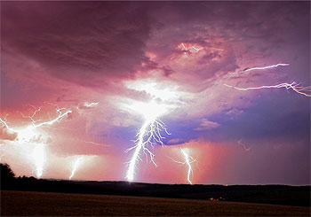
QUESTIONS?
Notes:
Send: steve@tihhomes.com
jykallman@gmail.com

Slide 64
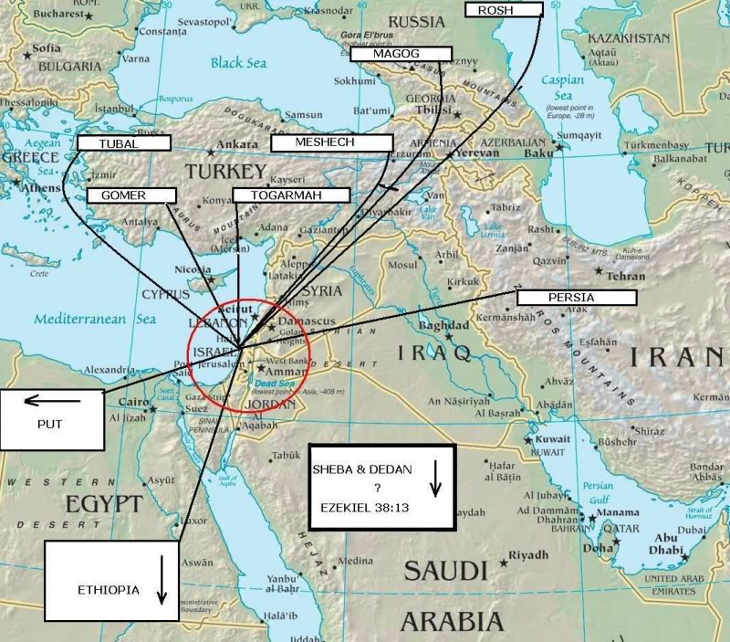
1854
Notes:
Source Top Map: http://prophecyunfolding.files.wordpress.com/2012/06/invasion-israel.jpg
Source of Bottom Map: http://www.godweb.org/maps/131.htm
“The World As Known To The Hebrews”, a map from the Historical Textbook and Atlas of Biblical Geography by Coleman, written in 1854, clearly identifies the nations of Magog, Meschech, Tubal, Ashkenaz, and Gomer as being in the region of the Caucasus and Turkey.
Source of Quote: http://johnthewitness.wordpress.com/2012/06/29/the-muslim-brotherhood-victories-in-egypt-will-lead-to-counterfeit-gog-and-magog-war/
Also: “In his multi-volume work called The Natural History, Pliny identifies the ancient Lydian city of Hierapolis as being part of Magog. Built atop the cliffs, the city of Hierapolis controlled the water supply of the Lydian city of Laodicea six miles to the south. The city of Hierapolis was built by the Lydians and always under Lydian control until the Lydian Kingdom became part of the Persian Empire in 546 BC and then part of the Greek and Roman Empires that followed. Like Pliny, today’s archeologists also identify Magog with the ancient nation of Lydia, which was in western Asia Minor. Indeed, written records from the Assyrian royal court show that the Assyrians used the name Magog as an eponym for the nation of Lydia. In his book Pliny writes, “Bambyx the other name of which is Hierapolis, but by the Syrians called Magog.”* In other words, Pliny identifies the famed Lydian city of Hierapolis as being part of Magog. In this we see that Magog is another name for the ancient nation of Lydia.”

